Slide 1
[This slide is to be deleted when using this template]
Boston Children’s has an opportunity to transform live talks into enduring on-line materials for on-line courses that serve both our internal learners and an external audience.
Our goal is to maximize efficiencies in converting live talks for online courses. We are requesting your help by standardizing your slide formatting and presentation structure using the following this template, as well as the guidelines and tips.

Slide 2
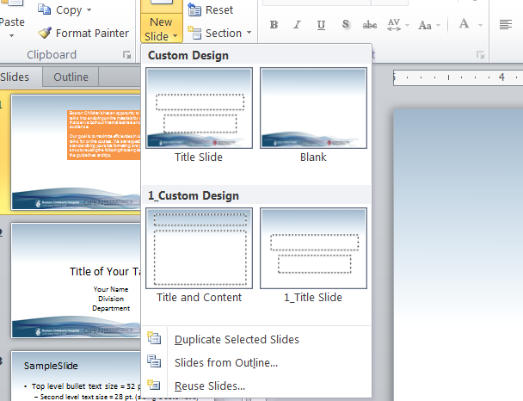
Tip:
Use the new slide menu to add desired slide type, e.g., Title or content

Slide 3
Sample Content Slide - Text
[This slide is to be deleted when using this template]
Text Sizing
  Header = 36, top level bullet = 32, sub-bullet = 28
  Sizing is automatic
  Try to avoid a third level of bullet
Try not to resize text and get creative
  Consider additional slide for extensive text
  When using abbreviations (abbr) to save space, explain them.

Slide 4
Sample Content Slide - Figures
Whenever possible, use SmartArt or other customizable figure templates to help convey concepts rather than bulleted text
This will help viewers maintain interest and better understand concepts

Slide 5
Title of Your Talk
Your Name
Division
Department

Slide 6
Disclosures
The first few introductory slides include disclosures, learning objectives, and a list of sections. The introduction should be kept short.

Slide 7
Learning Objectives
Learning Objectives should be
Limited: ~ 3-5
Outcomes oriented:
what do learners to know/understand/be able to do to improve outcomes?
Actionable:
what should learners do or change?

Slide 8
Introduction & Overview
If the content lends itself to sectioning, it is preferable to break your talk down into 3-5 sections, with an introduction and summary points for each section.
Give your learners a brief overview of what you are going to be talking about.
For example:
Background
Epidemiology
Presentation
Diagnosis
Treatment
Section 1
Section 2
Section 3
Section 4
Section 5 and Overall Conclusion
t
t

Slide 9
SECTION 1 TITLE

Slide 10
Section 1 Information
Add additional information slides as necessary

Slide 11
Section 1 Summary Points
Key points from the section you want learners to take away from this section.

Slide 12
SECTION 2 TITLE

Slide 13
Section 2 Information
Add additional information slides as necessary

Slide 14
Section 2 Summary Points
Key points from the section you want learners to take away from this section.

Slide 15
SECTION 3 TITLE

Slide 16
Section 3 Information
Add additional information slides as necessary

Slide 17
Section 3 Summary Points
Key points from the section you want learners to take away from this section.

Slide 18
SECTION 4 TITLE

Slide 19
Section 4 Information
Add additional information slides as necessary

Slide 20
Section 4 Summary Points
Key points from the section you want learners to take away from this section.

Slide 21
SECTION 5 TITLE

Slide 22
Section 5 Information
Additional information slides as necessary

Slide 23
Section 5 Summary Points
Key points from the section you want learners to take away from this section.

Slide 24
Final Take-home Points
Final take-home points reiterate the section summaries in support of the learning objectives

