Slide 1
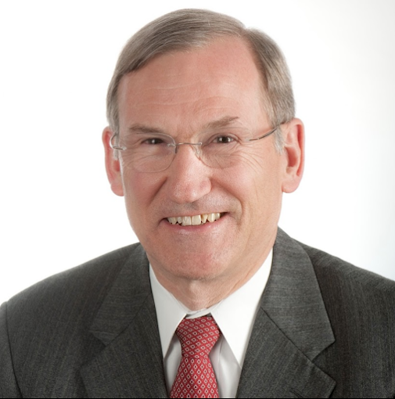


Slide 2
Content Layout Slides
Content Layout Slides

Slide 6
Charts/Graphs

Slide 7
Charts/Graphs

Slide 8
Charts/Graphs

Slide 9
Charts/Graphs

Slide 12
Team Headshots

Slide 21

10,000
xxx xx xxxxx xxxxxxx xx xxxxx xx xxxxx
10,000
xxx xx xxxxx xxxxxxx xx xxxxx xx xxxxx
10,000
xxx xx xxxxx xxxxxxx xx xxxxx xx xxxxx
10,000
xxx xx xxxxx xxxxxxx xx xxxxx xx xxxxx

Slide 22
Xxxxx
Xxxxxx
Xxxxx
Xxxxxx
Xxxxx
Xxxxxx
Xxxxx
Xxxxxx

Slide 23
Timeline
Month
2021
Xxxxxx
Month
2022
Xxxxxx
Month
2023
Xxxxxx
Month
2022
Xxxxxx
Month
2022
Xxxxxx

Slide 24
12,345
Xxxxxx
12,345
Xxxxxx
12,345
Xxxxxx
12,345
Xxxxxx
12,345
Xxxxxx
12,345
Xxxxxx
12,345
Xxxxxx
12,345
Xxxxxx

Slide 25
Xxxxxx
Xxxxx
Xxxxx
Xxxxx
Xxxxx
Xxxxx
Xxxxxx
Xxxxx
Xxxxxx
Xxxxx
Xxxxxx

Slide 26
Xxxx
Xxxxx
Xxxxxx

Slide 27
Xxxxxx
Xxxxxxx
Xxxxxxx

Slide 28
Xxxxxxx xx xxxx xx | Xxxxxxx xx xxxx xx | Xxxxxxx xx xxxx xx | Xxxxxxx xx xxxx xx | Xxxxxxx xx xxxx xx

Slide 29
Xxxxxxx xx xxxx xx | Xxxxxxx xx xxxx xx | Xxxxxxx xx xxxx xx | Xxxxxxx xx xxxx xx | Xxxxxxx xx xxxx xx

Slide 30
Xxxxxxx xx xxxx xx | Xxxxxxx xx xxxx xx | Xxxxxxx xx xxxx xx | Xxxxxxx xx xxxx xx | Xxxxxxx xx xxxx xx

Slide 31
Xxxxxxx xx xxxx xx | Xxxxxxx xx xxxx xx | Xxxxxxx xx xxxx xx | Xxxxxxx xx xxxx xx | Xxxxxxx xx xxxx xx

Slide 32
Xxxxxxx xx xxxx xx | Xxxxxxx xx xxxx xx | Xxxxxxx xx xxxx xx | Xxxxxxx xx xxxx xx | Xxxxxxx xx xxxx xx

Slide 33
Charts

Slide 34
1 NIH Award by Location & Organization (data frozen at end of FY) , https://report.nih.gov/award/index.cfm

Slide 35
$410M
Millions
Boston Children’s Hospital

Slide 36
6
CMI
Pediatric case mix index (CMI¹),
all neonatal patients

Slide 37
Congenital¹ heart surgery postoperative median length of stay 2014-2018^{1,2}
Example: Surgical | Price differential vs. Longwood
Anesthesia | 20%
OR | 28%
Recovery | 31%
Example: Radiology | Price differential vs. Longwood
CT | 30%
Diagnostic radiology | 20%
MRI | 35%
Ultrasound | 25%
Least
complex
Most complex

Slide 38
61
64
69
77
68
45
106
83
4
65
125
Top 25 journals determined by Eigenfactor impact score.
Recognized by the National Institutes of Health (NIH), the Eigenfactor Project evaluates the influence of scholarly literature.

Slide 40
Source: Boston Children's Hospital
(1) Average share of volume by location, FY2015-2017
(2) FY2017 Boston Children’s ED case volume

Slide 41




1.9 million
1.1 million
558,000
93,000
1.9 million
Massachusetts residents covered by MassHealth
1.1 million
MassHealth enrollees eligible for managed care
558,000
Pediatric managed care enrollees
93,000
Boston Children’s ACO enrollees

Slide 43
Logos

Slide 44



Slide 45
Icons

Slide 46

































Healthcare

Slide 47
































Healthcare

Slide 48
Money & Internet

Slide 49
Money & Internet

Slide 50






Business

Slide 51







Business

Slide 52
Thank You!
See you at our hybrid conference in 2024.

